Slide 1
QuizApp
Notes:
<Mark>
So we’ve called you here today to talk about QuizApp, a potential revolution in quiz administration.

Slide 2
Meet the Team
Mark Fuller (Project Manager)
Thanh Dat Le
Nicholas Riley
Enelson Castro
Michael Santiago
Notes:
<Michael>
[Everyone introduces themselves in order]

Slide 3
Why QuizApp?
1
Academics with ease
Notes:
<Michael>
We imagine that the first question on your mind is “What is QuizApp”? Before we talk about “What” QuizApp is, let’s talk about “Why” QuizApp is. What problem is there to solve?

Slide 4
“Good teaching is one-fourth preparation and three-fourths pure theater.”
Gail Godwin
Notes:
<Michael>
Gail Godwin was a Professor of English Literature at the University of Iowa. How do we ensure that only 1/4th of our time teaching is spent preparing?
[Say this information about Godwin, don’t put it in the slide-this makes her seem more important. We’re acting as if she’s famous enough for our audience to know who she is, and explaining for presentation’s sake-it’s a nice trick].
[Godwin is also a semi-famous novelist, feel free to mention that]

Slide 5
The Problem with that 1/4th
Time and effort spent making quizzes
Proctoring quizzes
Relying on middlemen
Canvas
Clickers
TAs
Notes:
<Michael>
Professors shouldn’t have to spend more than 1/4th of their effort preparing quizzes.
Need to use third-party websites, third-party clickers, spending resources on TA grading, it’s a mess. Laptops and tablets run out of battery when taking canvas quizzes, clickers are expensive and unreliable, paper costs money and takes time to print, distribute, and grade
[Sell it! Showmanship! Act like the problem is more severe than it is!]

Slide 6
‘99% of UCF students own a smartphone’
2016 Survey at UCF
Notes:
<Michael>
Study at our very own campus shows that 99% of the student body uses smartphones-and that was three years ago! That number could easily be approaching 100% in 2019! Smartphones are an integral part of day-to-day life in 2019. Everyone has a smartphone.
Students don’t need a clicker. They’ve already bought what they need!
[Possibility: Ask the audience if they own a smartphone. Show of hands? “How many of you have a smartphone in your pocket right now!”]

Slide 7
Moving Quizzes to Mobile
2
Using mobile apps and web interfaces for quizzing
Notes:
<Enelson>
Let’s modernize our paradigm. We have the full power of the smartphone age at our disposal, and it’s time to use it!

Slide 8
Electronic Quizzes
Make quizzes online
Set automatic quiz start and end times
Proctor quizzes automatically through an app
Get quiz results from a handy database
Notes:
<Enelson>
[Talking about the general idea of the app here.]

Slide 9
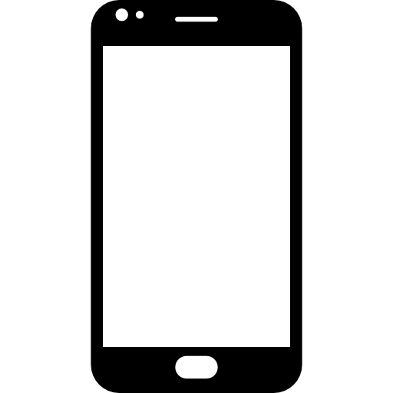

Hybridization
Half-web, half-mobile: use all the tools of the modern age to simplify the process
Notes:
<Enelson>
Hybridization! Our project isn’t bound by the limits of one tool, we’re using everything we have available to us.
[Gotta stuff jargon into these slides whenever we can. We’re the future! Push the future!]

Slide 10
On the Web
Web app is only accessible to instructors
Control panel for instructors to manage their quizzes
Instructors use this app to:
Write questions
Build quizzes from questions
Modify existing quizzes and questions
Set start and end times
Get quiz results
Notes:
<Enelson>
[Just go through these bullet points; add a bit more specific information when talking]

Slide 11
On Mobile Device
Used by students
Register as a student
See which quizzes they are eligible for
Start quizzes during their designated periods
When taking a quiz:
Read questions
Choose from up to five answers
Move between questions
Submit their quizzes
Notes:
<Enelson>
[Just go through these bullet points; add a bit more specific information when talking]

Slide 12
Who Benefits?
Professors and students alike!
Notes:
<Enelson>
Much like how our app functions through the cooperation of the world of mobile phones and web applications, academia is a similar contract between professors and students. And both parties will benefit from this app! Professors get a simple way to build, distribute, and grade their quizzes, while students get a straightforward tool to take their quiz with!

Slide 13
Monetization
Subscription model for professors
One semester, one class payment model
Accounts with multiple classes get a discount on each class
Notes:
<Enelson>
Professors pay a fee for each semester for a license to use the app portion of QuizApp.

Slide 14
Web App
3
The development process for QuizApp
Notes:
<Nicholas>
So QuizApp provides a convenient way for instructors to run quizzes and for students to take them. That takes us to our next step: how are we going to build QuizApp?

Slide 15
Technology Used
Web
LAMP Stack
Linux
Apache
MySQL
PHP
Vue.js
Mobile
Android Studio
Java
Server
MySQL
Notes:
<Nicholas>
We’re going to create the Web app using the LAMP stack, as it’s a set of software tools this team is already familiar with. We’ll also be adding Vue.js to our toolkit to make an aesthetically-pleasing website. Vue is a hot new open-source framework getting popular.
Our mobile app is going to be designed in Java using Android Studio. While our project’s prototype launch will be exclusive to Android phones, developing with YAML will allow us make app portable to other mobile devices in the future.
The apps will communicate using a mySQL database stored on the server.

Slide 16
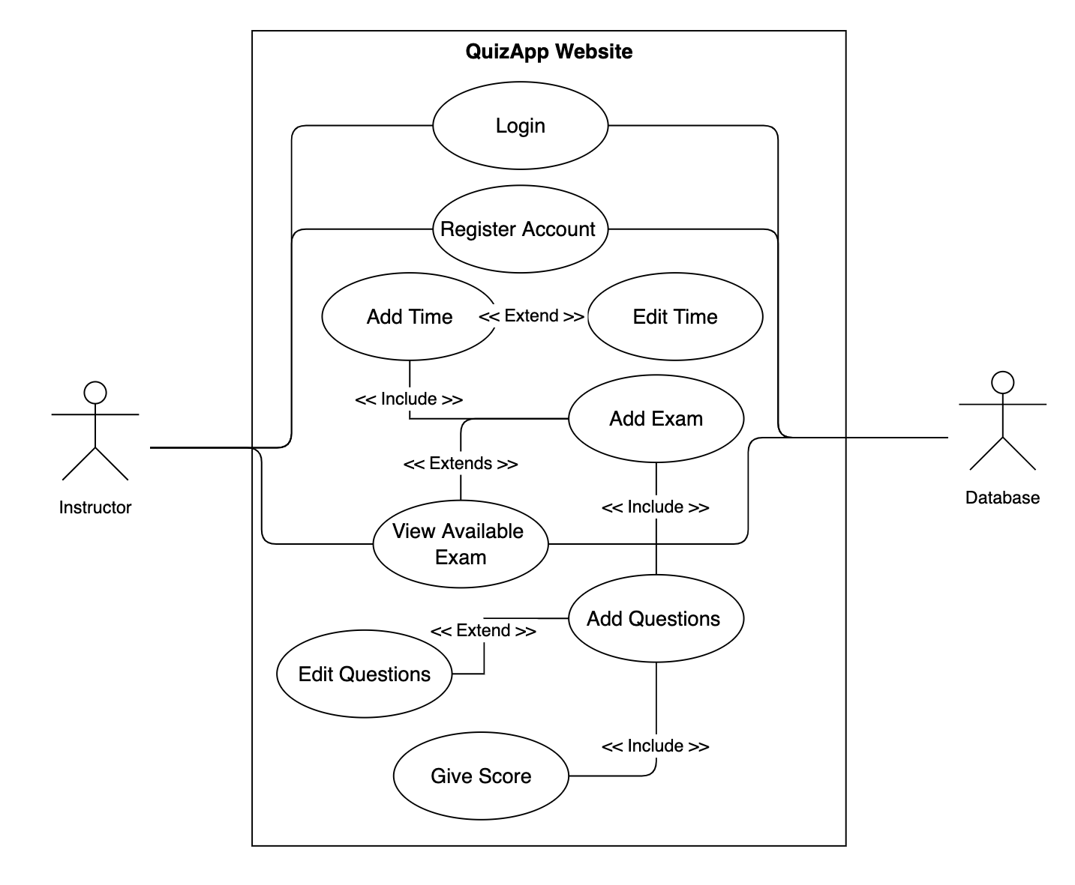
Web Use-Cases
Notes:
<Nicholas>
[Place the use-case diagram here. It should just about repeat everything from the previous slides.]

Slide 17
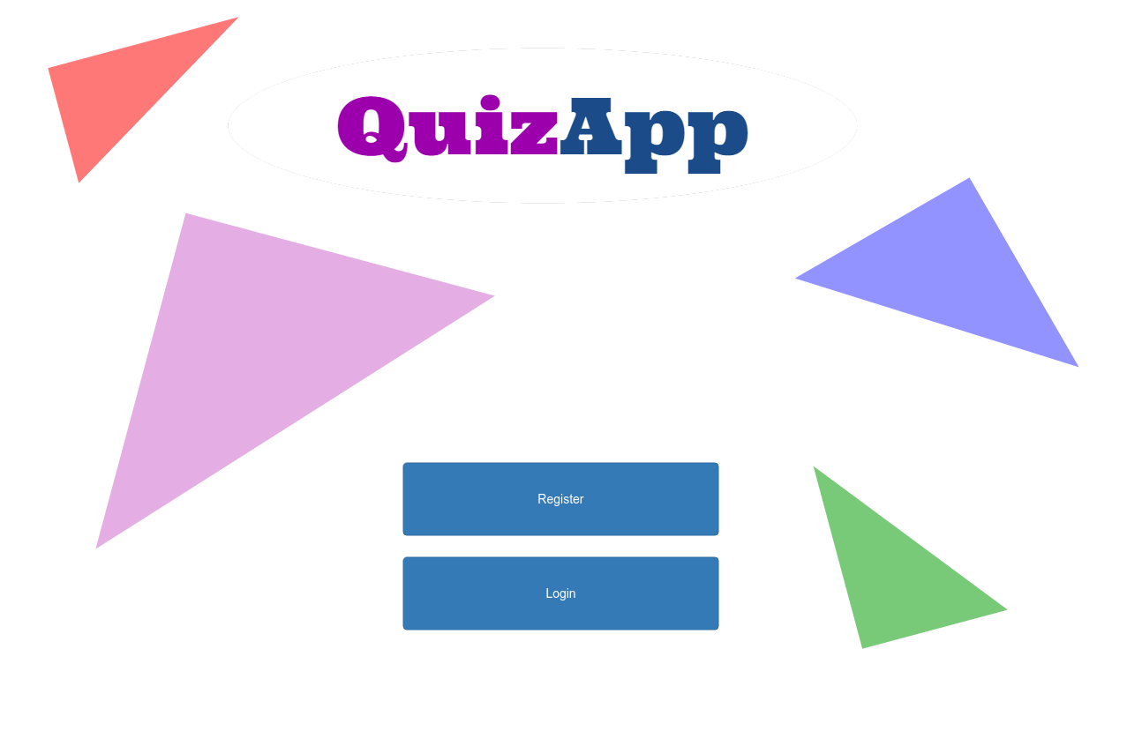
QuizApp Website
Notes:
<Nicholas>

Slide 18
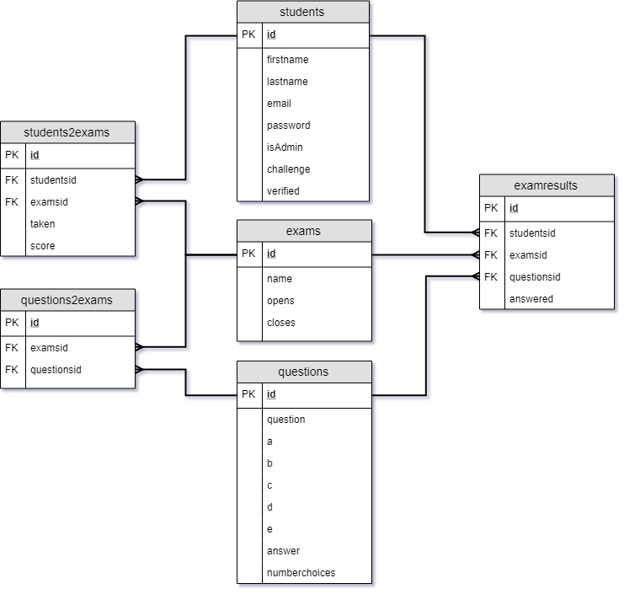
Entity-Relationships
Notes:
<Mark>
[ERD goes here. Explain concept of question bank, linking questions to quizzes, assigning students to classes, etc]

Slide 19
Mobile App
4
The development process for QuizApp
Notes:
<Dat>
So QuizApp provides a convenient way for instructors to run quizzes and for students to take them. That takes us to our next step: how are we going to build QuizApp?

Slide 20
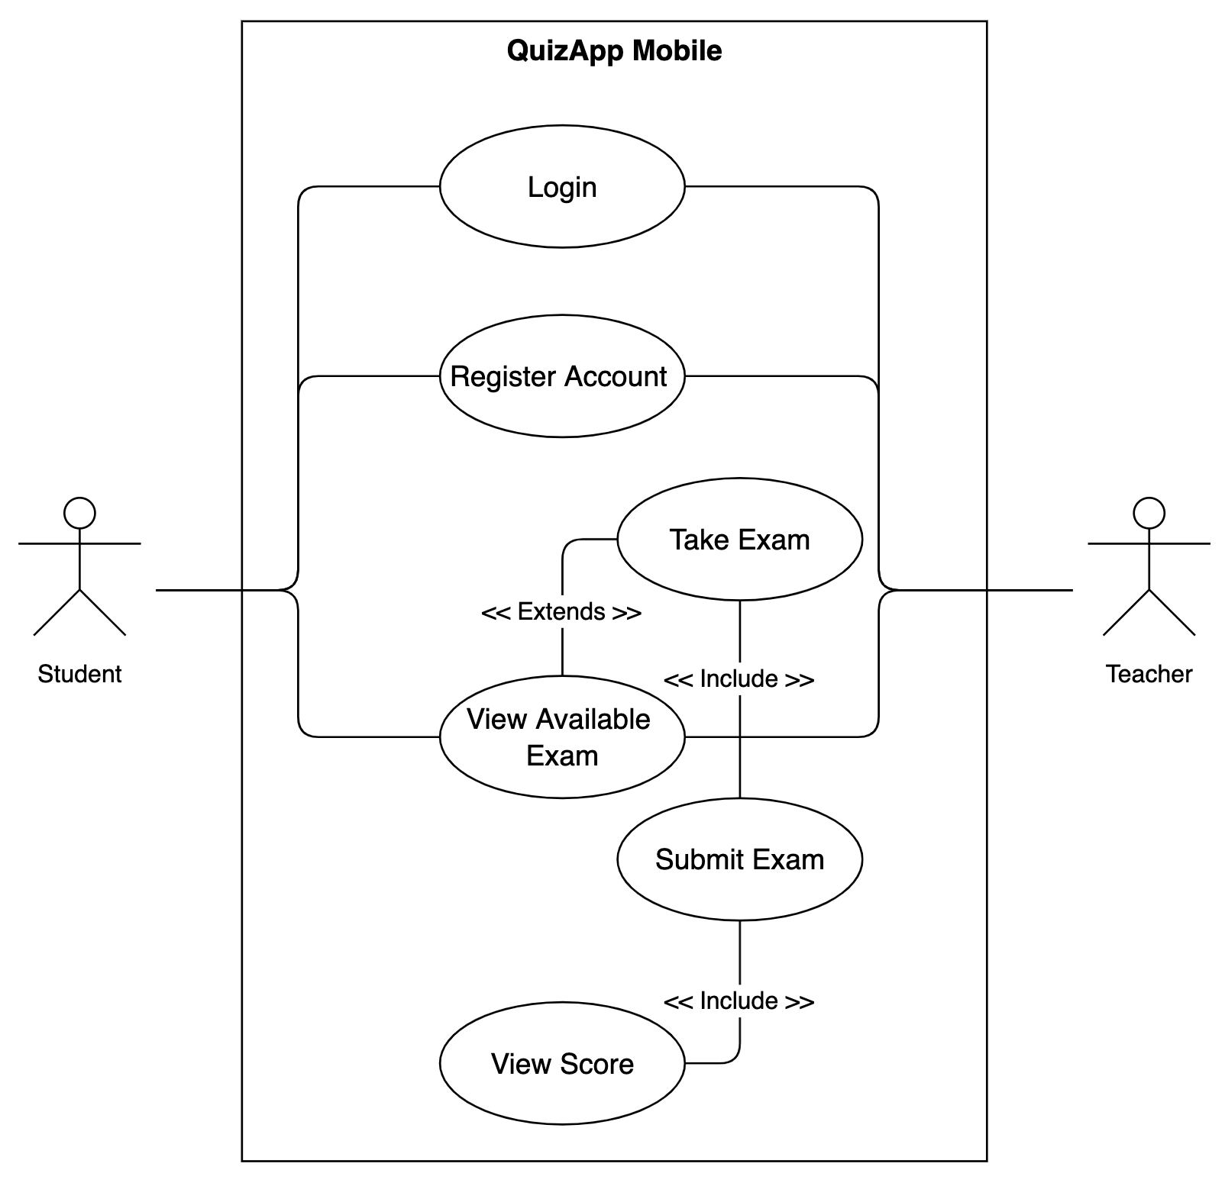
Mobile Use-Cases
Notes:
<Dat>

Slide 21
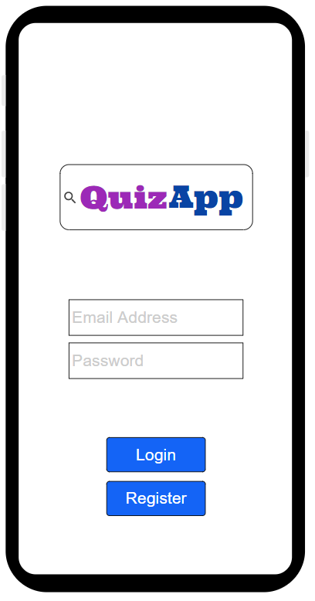
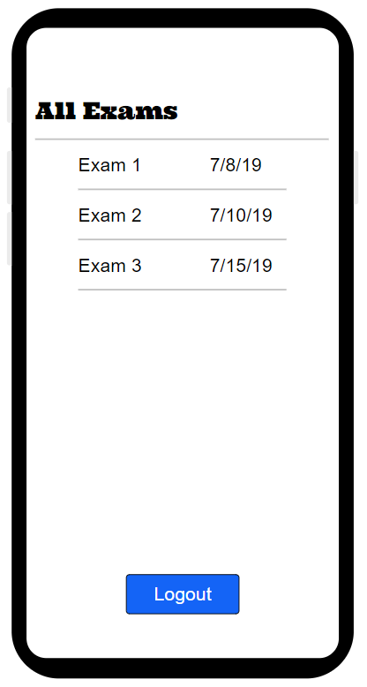


QuizApp Mobile Login & Register
Notes:
<Dat>

Slide 22
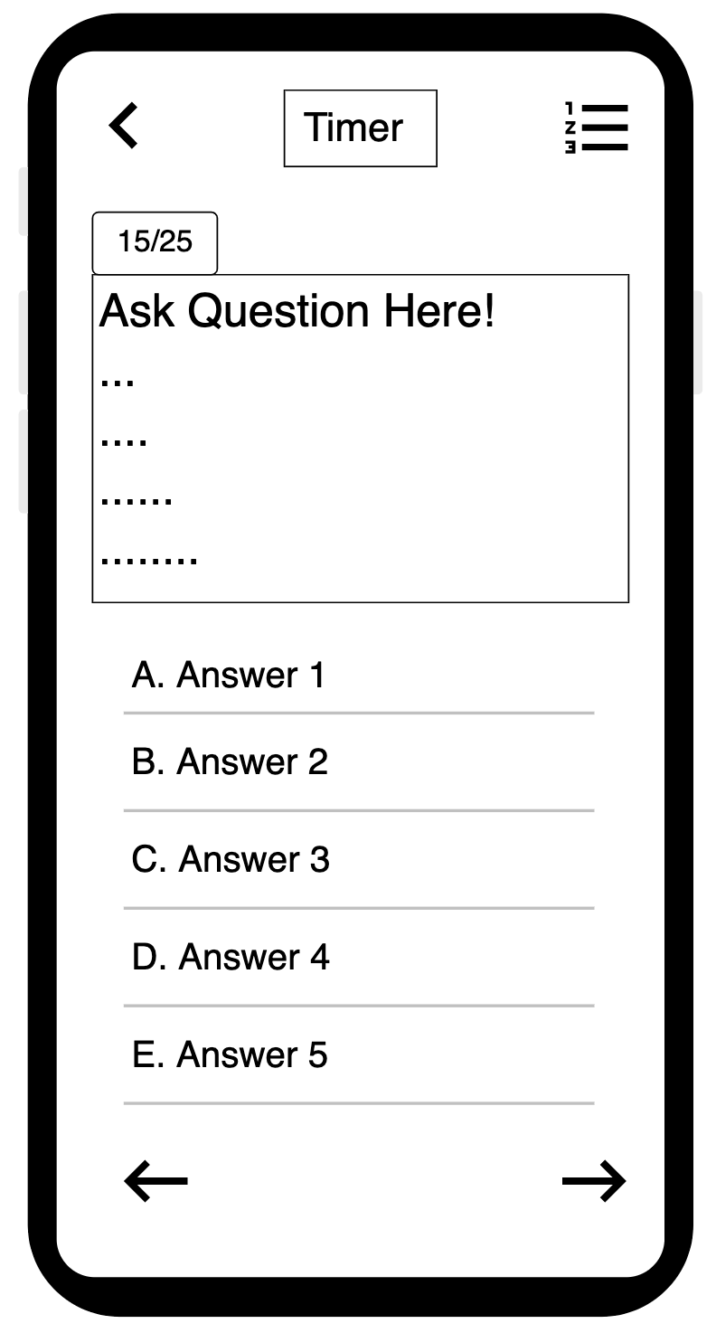
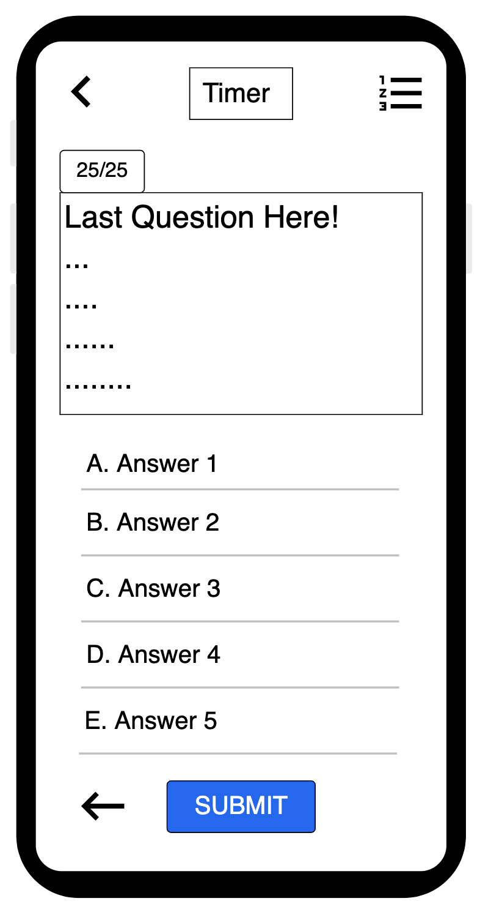
QuizApp Mobile Questions
Notes:
<Dat>

Slide 23
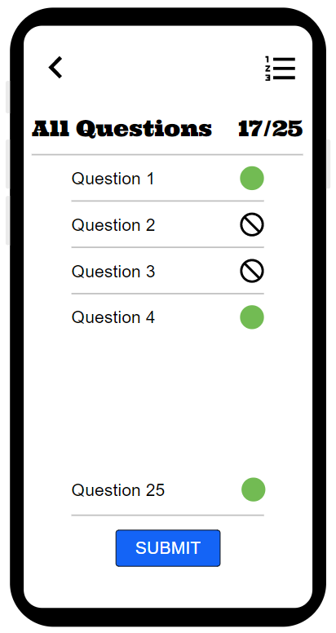
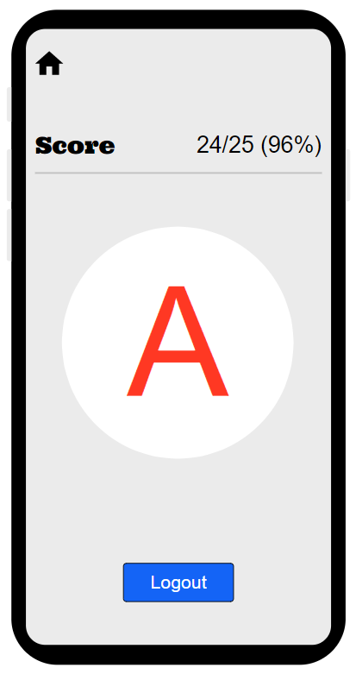
QuizApp Mobile Submit & Score
Notes:
<Dat>

Slide 24
Project Timeline
5
The development process for QuizApp
Notes:
<Dat>
So QuizApp provides a convenient way for instructors to run quizzes and for students to take them. That takes us to our next step: how are we going to build QuizApp?

Slide 25
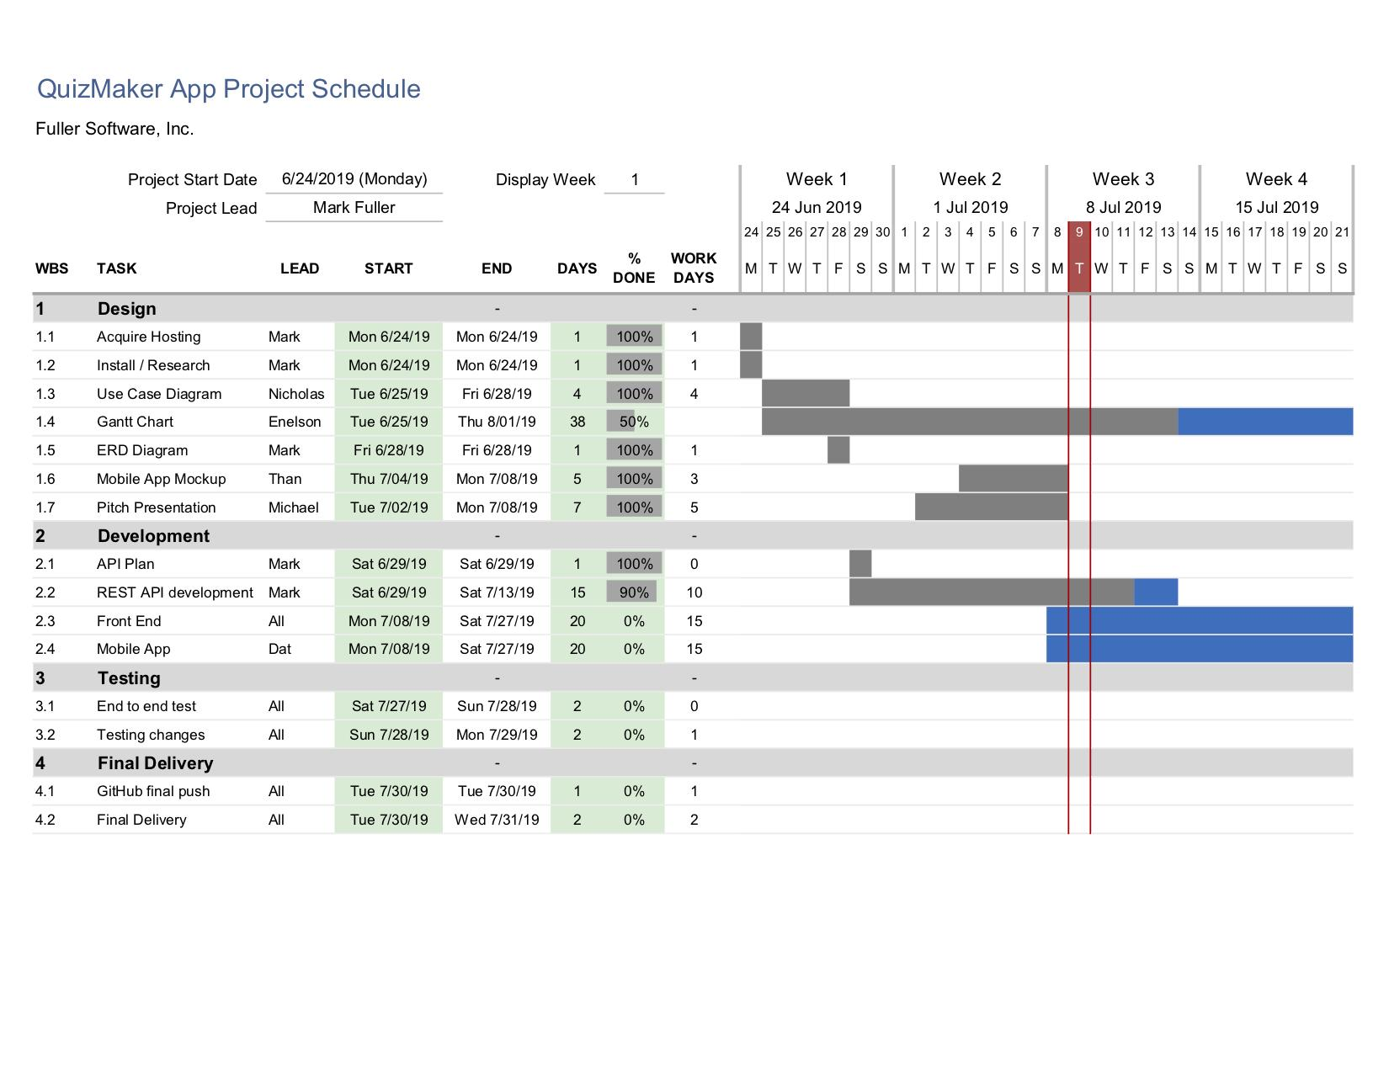
Gantt Chart Wk 1-4
Notes:
<Mark>

Slide 26
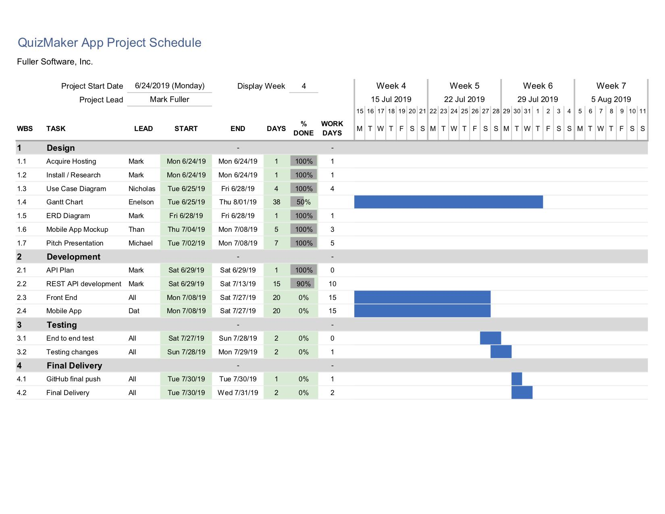
Gantt Chart Wk 5-7
Notes:
<Mark>

Slide 27
Questions?
Notes:
[Read off the credits, ask for questions.]

